Slide 1
Sudoku Level Generator (SLG) Final Product Demonstration
Team 5:
Chio Yong Kiong
Kong Chee Wee
Benjamin Leong Jia Juin
Nelson Tan Chun Soon
Date 10 AUG 2022

Slide 2
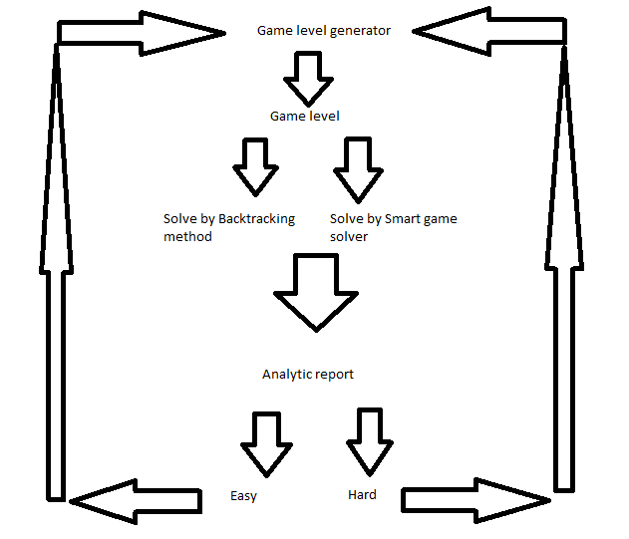
Overview of Sudoku Level Generator
Slide content

Slide 3
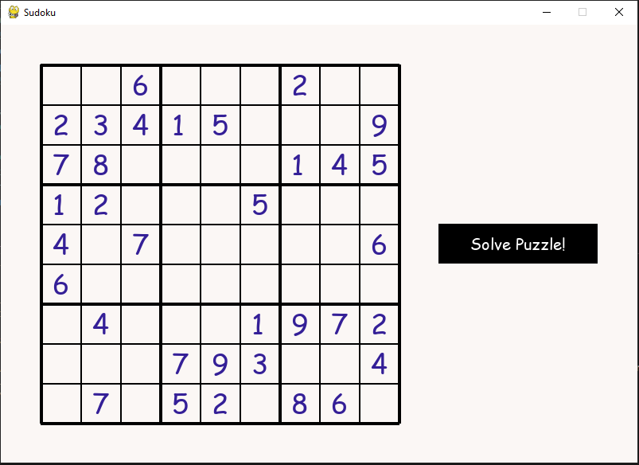
1st Window
On starting the program, the Game Level Generator is launched and it will generate a grid, which is the data file. The user can proceed to click "solve puzzle" to execute the algorithm to solve the puzzle.

Slide 4
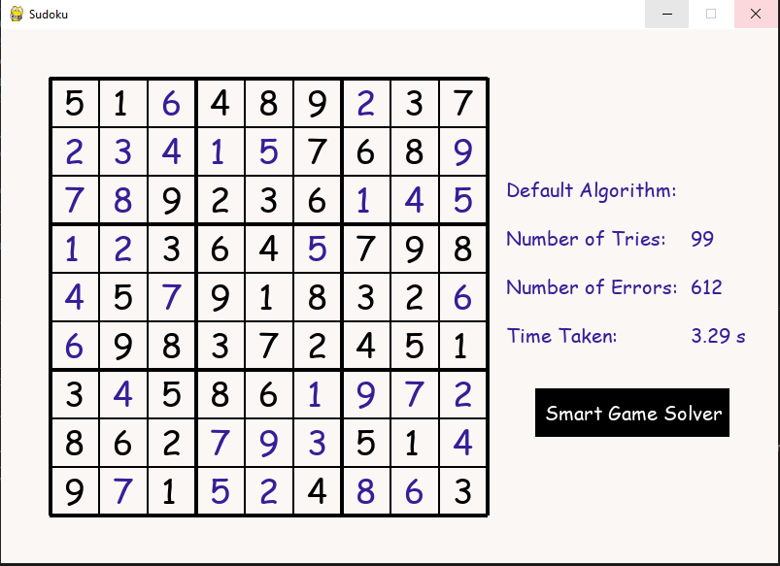
2nd Window
The default algorithm, which is the recommended solution, will proceed to solve the sudoku puzzle. The algorithm is analyzed using three indicators - number of tries, errors and time taken are shown. The user can proceed to click on "Smart Game Solver" to launch the Smart Game Solver (SGS), which will provide a more efficient algorithm to solve the puzzle.

Slide 5
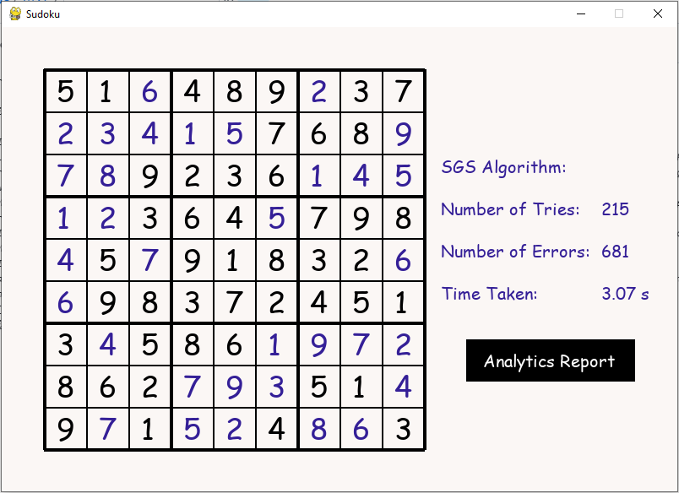
3rd Window
The SGS reads the data file (Sudoku grid) and solves it with a more efficient method. In the same way, it analyzes the algorithm with the same indicators as shown. The user can proceed to click on "Analytics Report".

Slide 6
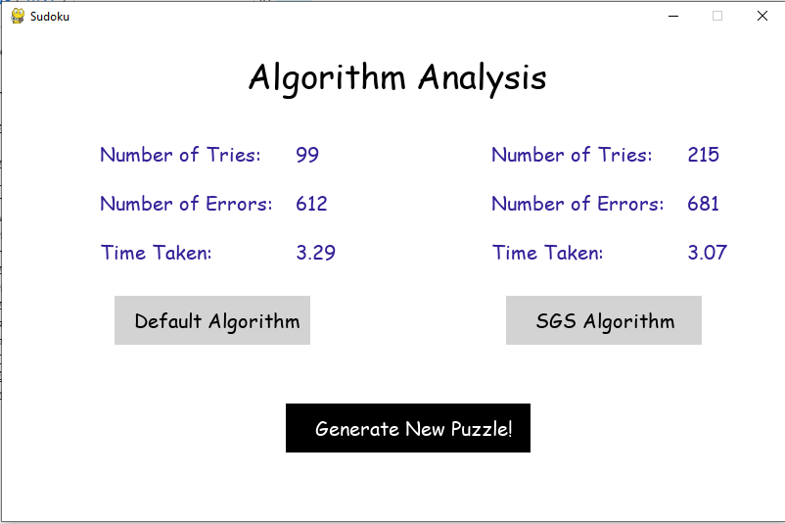
4th Window
Once clicked, the SGS generates analytics report that compares the two algorithms that were used to solve the puzzle. The user can proceed to generate a new grid.

Slide 7
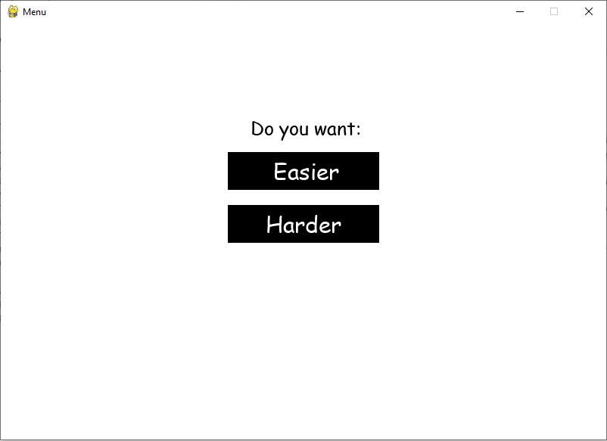
5th Window
There is an option to generate an "easier" or "harder" grid. When either one is selected, the SGS will use the indicators to generate a new puzzle. It will do that by taking the indicators of faster algorithm, run it through a calculation process that will produce a certain values. These values will be used to select an "easier" or "harder" grid from a list of grids.

Slide 8
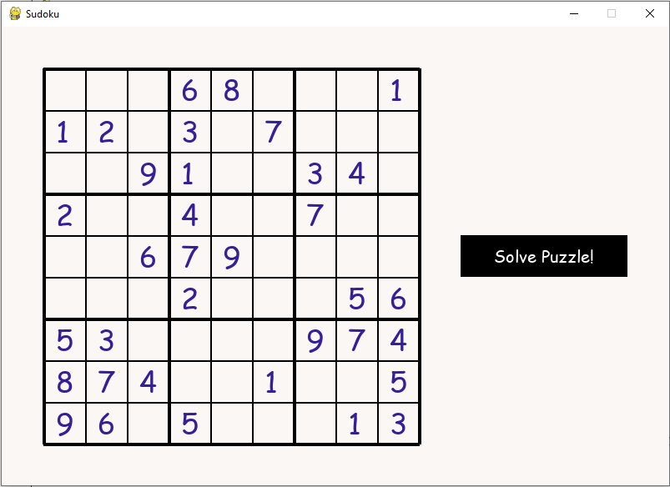
6th Window
The values are delivered back to the GLG, which will generate a new puzzle based on the user's selection.

Slide 9
Thank You!

